Slide 1


COMMON APP READY
Getting Started
© 2016 The Common Application • commonapp.org
Notes:
Welcome to Common App Ready – Getting Started.
This presentation will cover the processes of creating an account, walk through the Common App layout, and review searching for and adding colleges to your My Colleges list.

Slide 2
GETTING
STARTED
AGENDA
Creating Your Account
Common App Layout
Searching for & Adding Colleges
^{© 2016 The Common Application}

Slide 3
CREATING
YOUR
ACCOUNT
Creating a Common App account is easy! Simply go to commonapp.org and click the Create Account or Apply Now buttons to get started.
^{© 2016 The Common Application}
Notes:
The process begins at commonapp.org where applicants can create an account and sign in to the application.

Slide 4

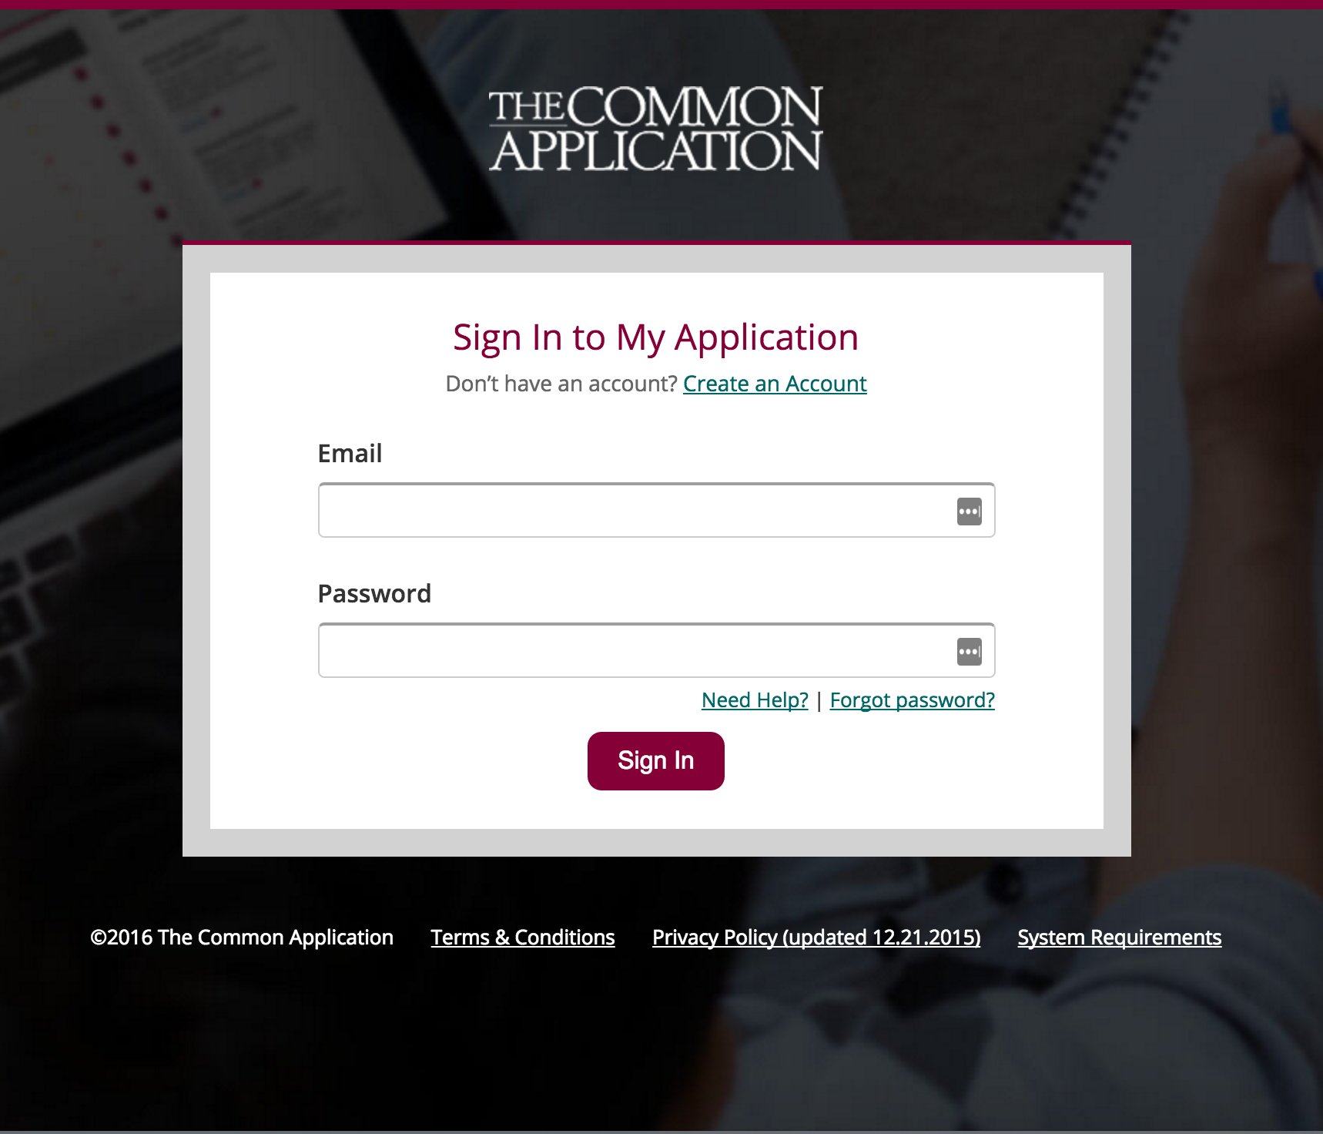
^{© 2016 The Common Application}
Notes:
There are two ways you can create an account.
Click the “Create Account” button.
Click the “Apply Now” button and then when prompted to sign in click the “Create an Account” link.
Then, follow a few quick steps and begin your application right away

Slide 5
Then follow these three simple steps to create your account.
Account Creation Steps:
Registration Type
Login Credentials
Registration Information
^{© 2016 The Common Application}
Notes:
Creating your account is an easy, 3-step process:
Select Your Registration Type
Enter Your Login Credentials
Enter Your Registration Information

Slide 6
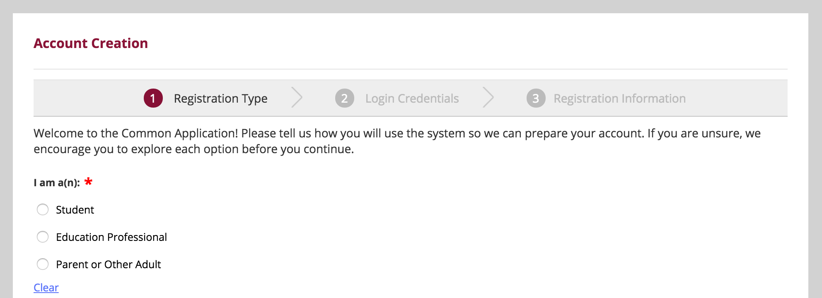
1. REGISTRATION TYPE
^{© 2016 The Common Application}
Notes:
First you need to select your registration type. The three types are:
Student: Student who plans to apply to college this year or at a later time.
Education Professional: Counselor, teacher, advisor, or other professional who works with applicants and wants to see the applicant experience without being considered for admission by colleges. This choice is not for students to plan to apply and study at college.
Parent or Other Adult: Parent or other adult who wants to see the applicant experience without being considered for admission by colleges. This choice is not for students who plan to apply and study at college.

Slide 7
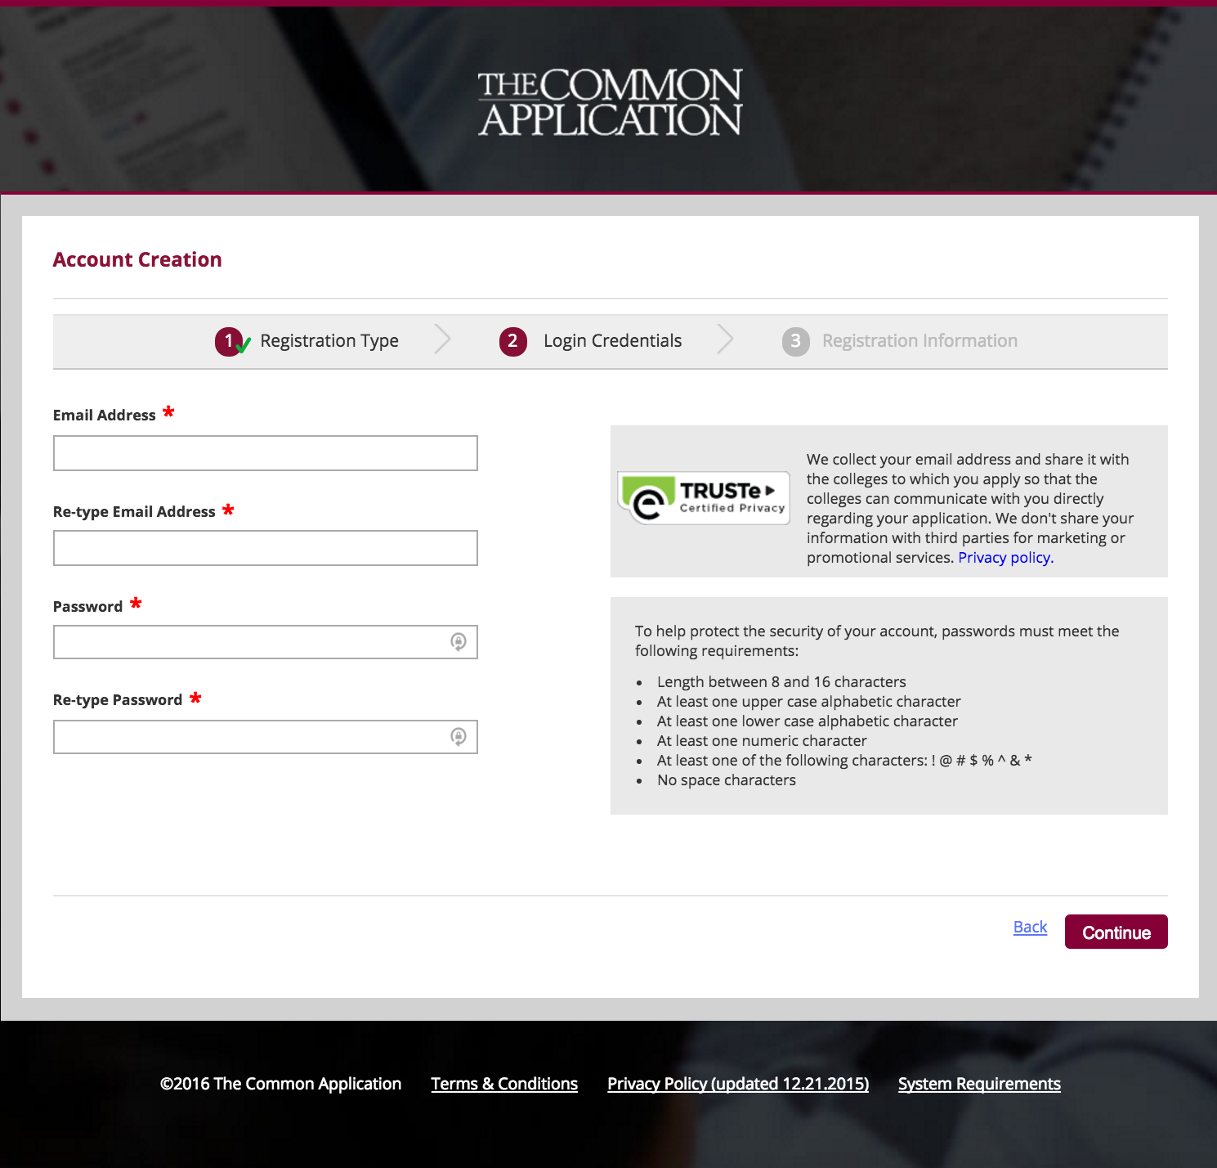
2. LOGIN
CREDENTIALS
^{© 2016 The Common Application}
Notes:
Make sure the email address you enter is one you check regularly in case the Common App and the colleges you’re applying to need to reach out to you concerning your application. Your email address will become the username you enter each time you log into the application.
It’s also a good idea to make note of your password and keep that reminder handy, since you’ll need to log in with your email address and password each time you access the Common App. If you lose your login information, the Common Application Applicant Solutions Center is always here to help, but it’s still a good idea to keep your password someplace safe so you can locate it later on if necessary.

Slide 8
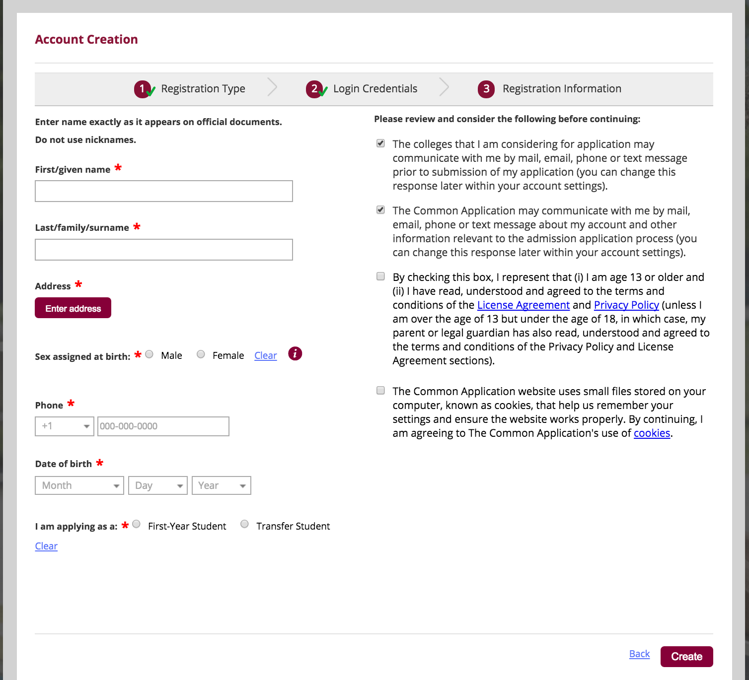
3. REGISTRATION
INFORMATION
^{© 2016 The Common Application}
Notes:
Applicants will need some basic profile information – like name, date of birth, address and phone number.
Students should use their legal name as it appears on official school documents and standardized test scores. This will allow colleges to match documents with the correct
applicant.
Applicants should use the mailing address where they would like all college related materials to be sent.
By checking the box indicating that you give permission to colleges and universities that you have added to your My Colleges list, you are allowing colleges to communication
with you prior to submission of your application. This communication might include deadline reminders, scholarship opportunities or other information that will help you in the
college admissions process.

Slide 9
COMMON
APP
LAYOUT
The Common App is divided into four tabs:
Dashboard
My Colleges
Common App
College Search
^{© 2016 The Common Application}
Notes:
The Common Application is organized into four tabs:
Dashboard, My Colleges, Common App, College Search

Slide 10
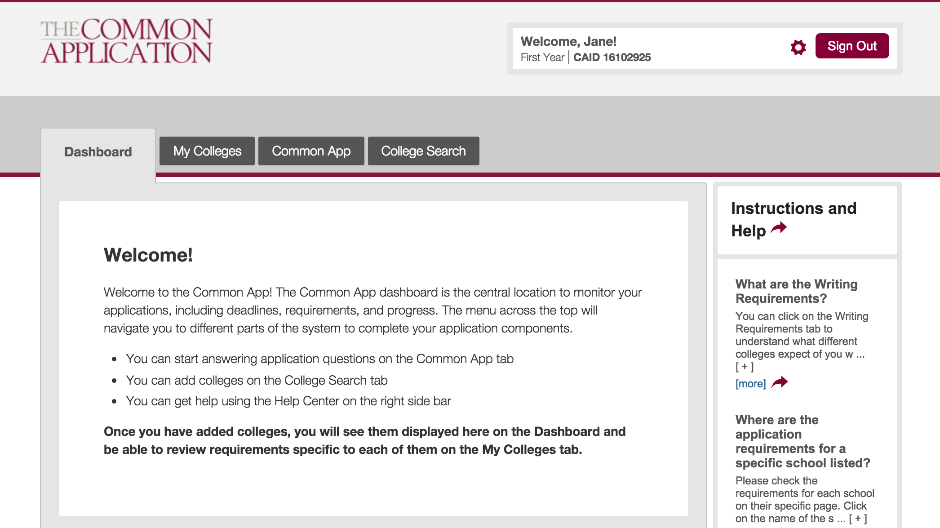
^{© 2016 The Common Application}
Notes:
Welcome to your account!
This is the welcome screen that applicants see when they first sign in to their Common App and will appear until a college or colleges are added to your My Colleges list.
The Common App ID (CAID) is the unique identifier that allows colleges to match your application with supporting documents. Write down this number with your important
college application information – it will be useful if you need to contact appsupport.commonapp.org.
Click on the gear icon to update or change your email address, password, or communication preferences.
On the right side of the screen, you will see the Instructions and Help Center link. This link appears in the same place on every page of your application. Help is available where you need it, when you need it. 24/7/365.

Slide 11
The Common App tab is where you will complete the six Common App sections. Watch these videos to learn more about them.
Search for and add colleges to your My Colleges list in the College Search tab.
In the My Colleges tab you will complete the college-specific questions for each college in your list.
The Dashboard is your home base where you can keep an eye on your requirements and upcoming deadlines.
Check out our Common App Tour video for more info!
^{© 2016 The Common Application}
Notes:
The Dashboard provides a snapshot of all of your colleges, including information on deadlines, requirements, and the submission status of your applications.
The My Colleges tab will list detailed informa8on about the colleges you have added to the list and requirements for all of your colleges.
The Common App tab is where you will go to complete the main sections of your application.
The College Search tab is used to search for colleges that you would like to add to your My Colleges list.

Slide 12
SEARCHING FOR &
ADDING
COLLEGES
With nearly 700 colleges in the Common Application, there’s one that’s right for you! Use the College Search tab to explore, learn, and add colleges to your list.
^{© 2016 The Common Application}
Notes:
Searching for and adding colleges to your My Colleges list is a great place to start your Common App.
There are almost 700 colleges in the Common Application.
You can add up to 20 schools / add and remove up until you submit.

Slide 13
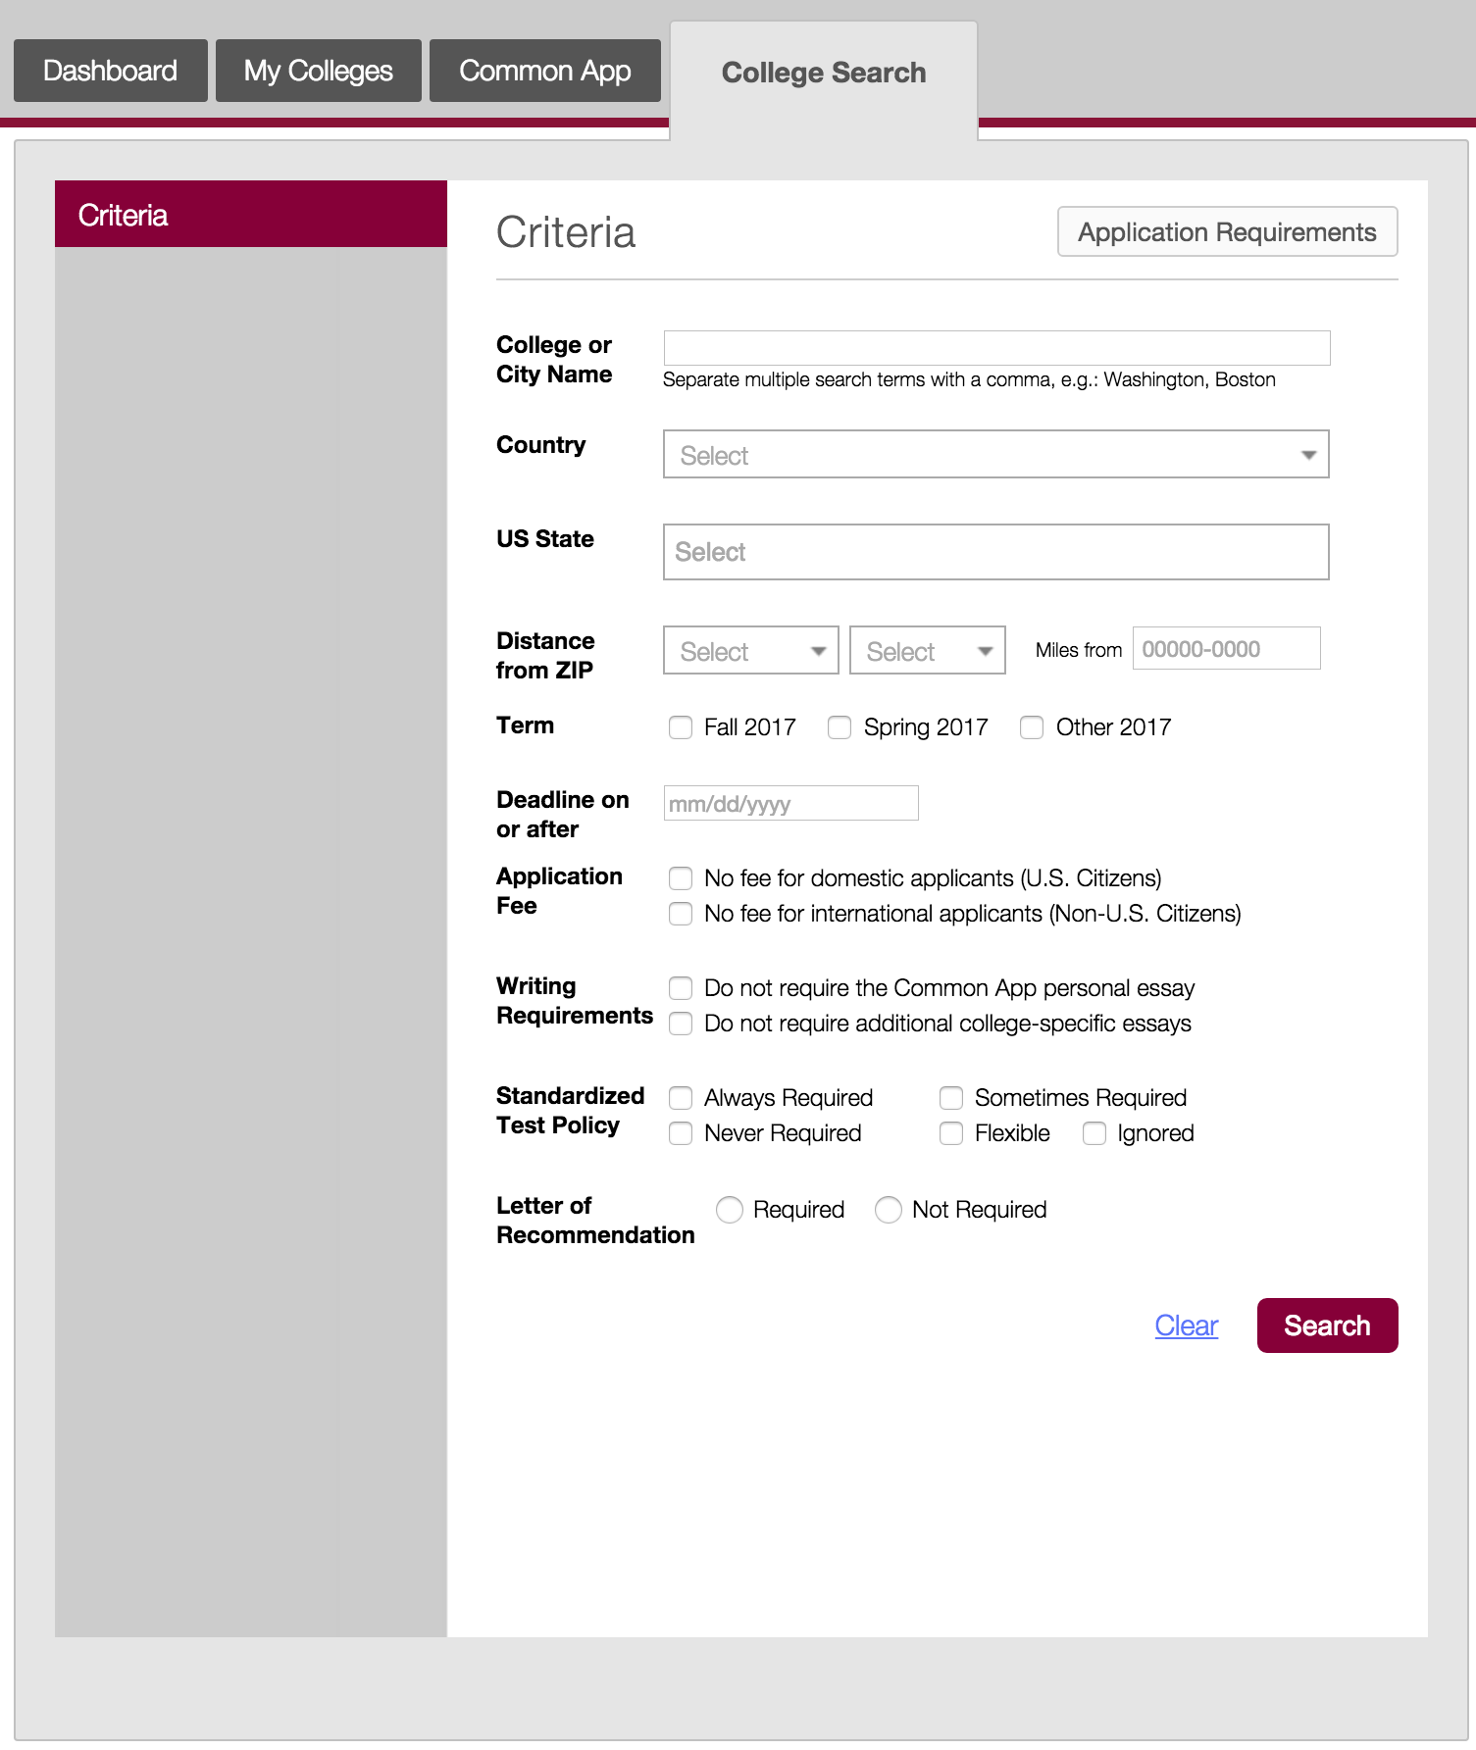
THE COLLEGE SEARCH TAB
^{© 2016 The Common Application}
Notes:
Search by a number of different criteria, including College or City Name, Country, US State, Deadline. You can also search by whether or not a school requires an application fee, as well as their writing requirements and testing policy.
Click on the Application Requirements button to download a full list of requirements for all schools that are a part of the Common Application.

Slide 14
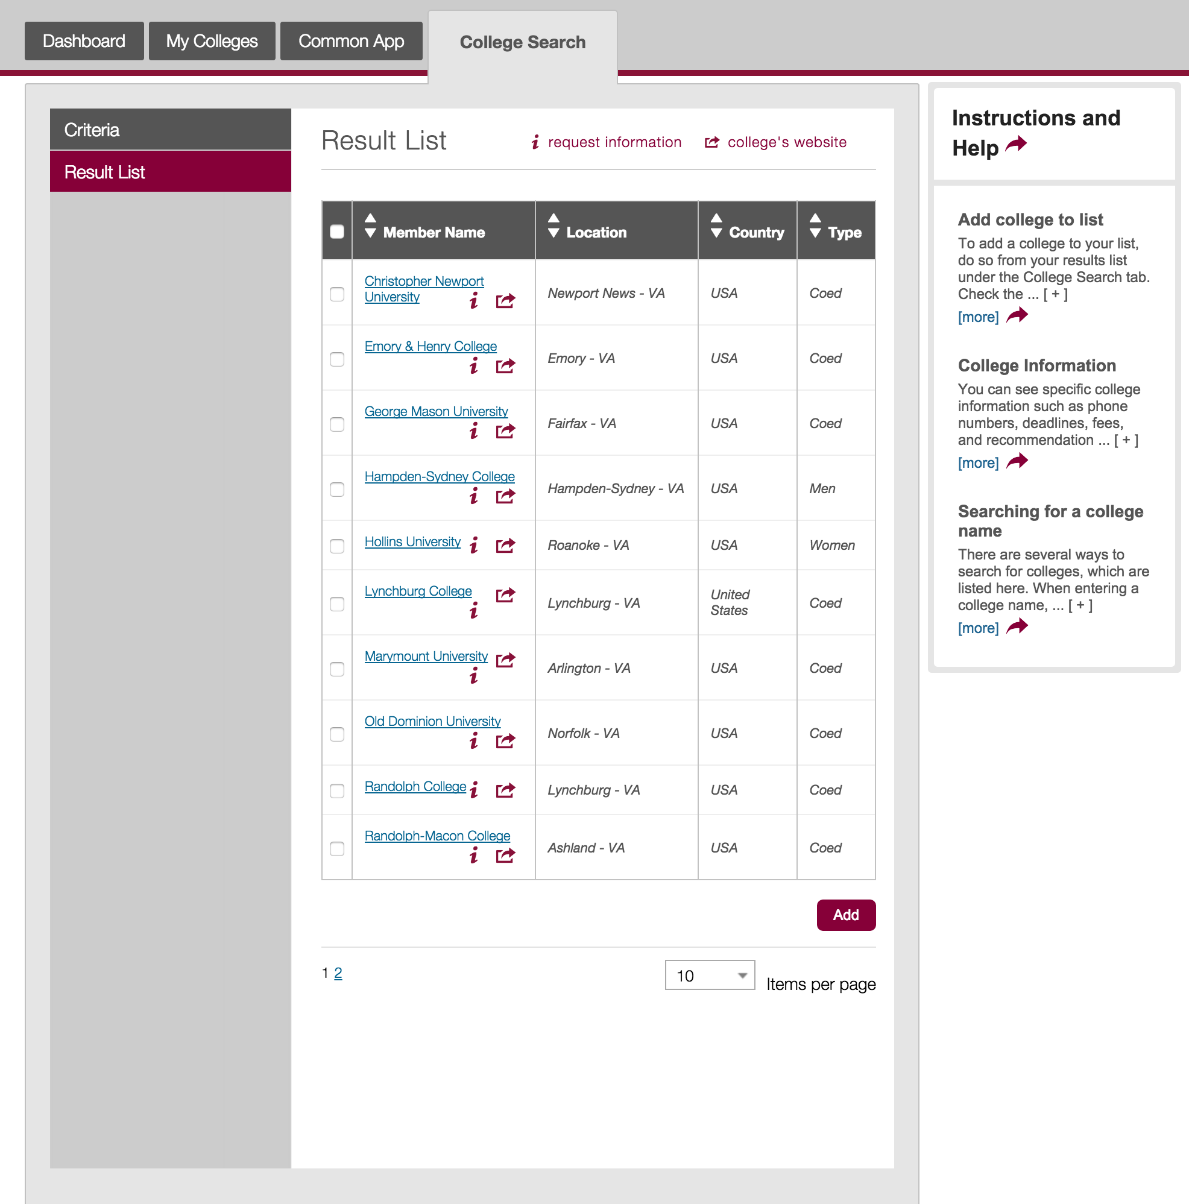
RESULTS LIST
^{© 2016 The Common Application}
Notes:
The results list shows all the colleges based on the criteria selected.
You can sort the results based on the Name, Location, Country, and Type.
You can also find more information about the colleges in the results list:
Click on the name of the school – this will open a page listing information about the school like their contact details and application requirements
Click the “i” icon to request more information from the school
The college’s website icon will take you to the school’s specific website to learn more about that particular school

Slide 15
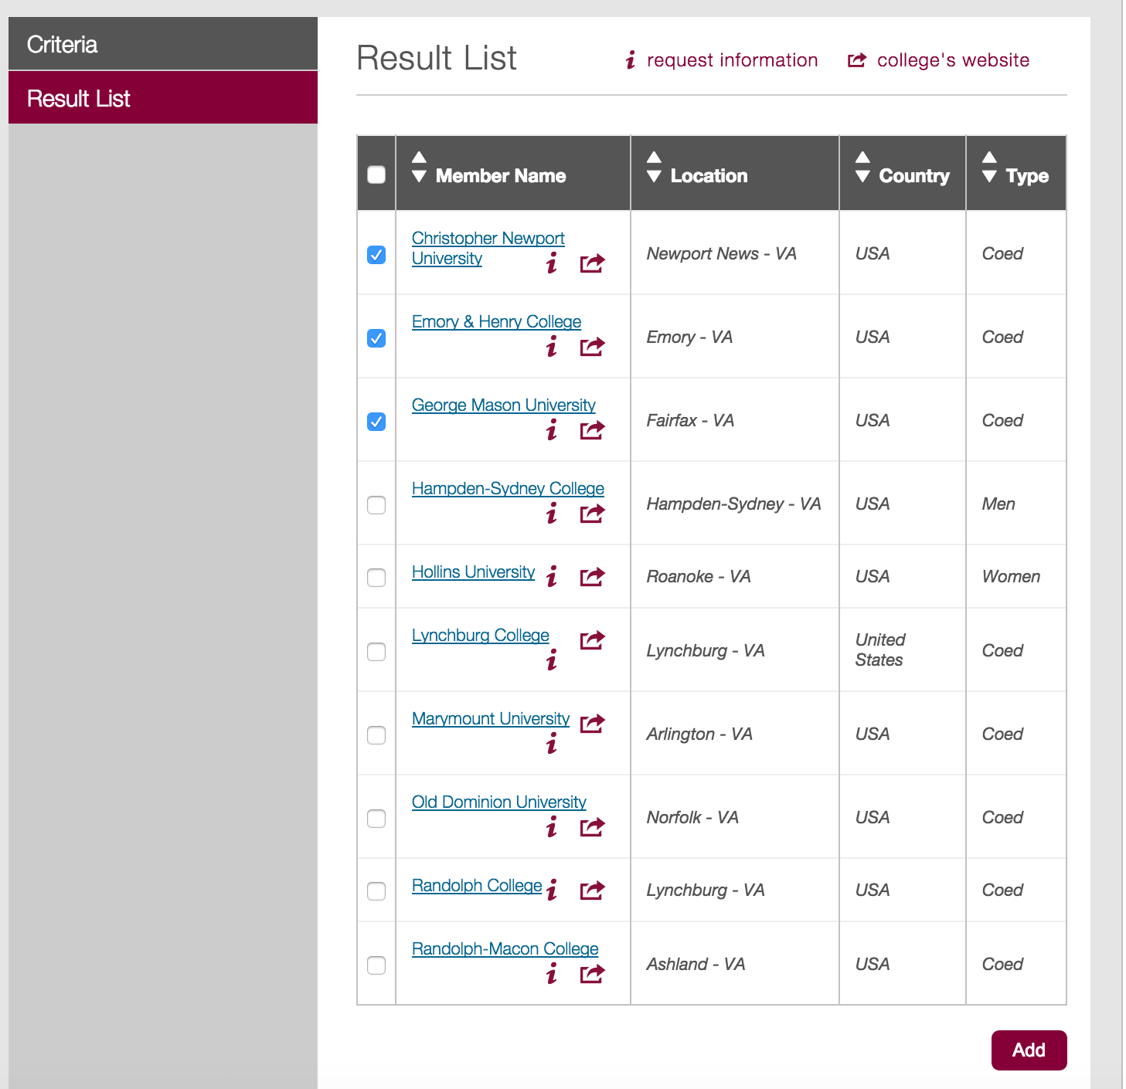
ADDING
SCHOOLS
^{© 2016 The Common Application}
Notes:
Adding schools to your My Colleges list is easy. Simply select the school(s) you want to add and then click the “Add” button. You can select multiple schools at once and add them all at the same time.

Slide 16
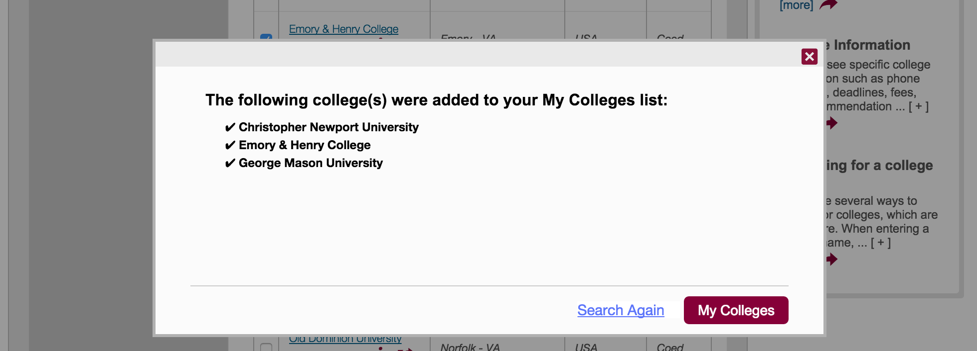
SUCCESS!
^{© 2016 The Common Application}
Notes:
And that’s it! Navigate to My Colleges to see the colleges you added or click “Search Again” to continue searching for and adding schools.

Slide 17




LEARN MORE
GATHER YOUR MATERIALS
TIPS & BEST PRACTICES
COMMON APP TOUR
Important information you’ll need for your application.
Best practices to keep in mind as you complete your applications.
Learn how to navigate the Common App.
^{© 2016 The Common Application}

